Slide 1
PATENT COMPARISON SYSTEM
Özlem Simay CELKAN
Neval Zeynep GÜNDEŞLİ
Öznur ÖZTÜRK
Mert KIZILDAĞ
Advisor: Dr. Öğr. Üyesi Murat SARAN

Slide 2
TABLE OF CONTENTS
01
04
02
05
03
06
SOLUTION
ABOUT THE PROJECT
METHOD
PROBLEM
RESULT
ANALYSIS

Slide 3
ABOUT THE PROJECT
While finding our finishing project, the most important issue was that it was an innovative project. As a result of our long research, we decided to implement the Patent Comparison System proposed by Onur Engineering and to develop it in the future.
Patent Comparison System briefly; It consists of obtaining a similarity ratio by comparing the title, description and claim parts of the patent contents with other patents registered in our database.

Slide 4

Company Information
ONUR, It was established in 1980 and has been serving the defense industry and public institutions of our country for more than 35 years.
ONUR, which started to gain experience in the defense industry sector by cooperating with consortia in its initial years, has developed its integration ability by working with foreign companies in various projects in the following years.

Slide 5
PROJECT GOALS
FAST
RELIABLE
USER FRIENDLY

Slide 6

PROBLEM

Slide 7
The patenting process is both a long and hard process. Due to the lack of sufficient systems, patent procedures take longer than necessary. Today, there is no system that allows this process to improve.

Slide 8

ANALYSIS

Slide 9
01. Were there any other applications that could be exemplary?
02. What did we pay particular attention to in the research?
03. What did we focus on a lot?

Slide 10

SOLUTION

Slide 11






Slide 12

METHODS

Slide 13



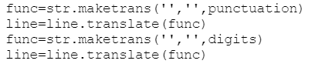

Slide 14




Slide 15

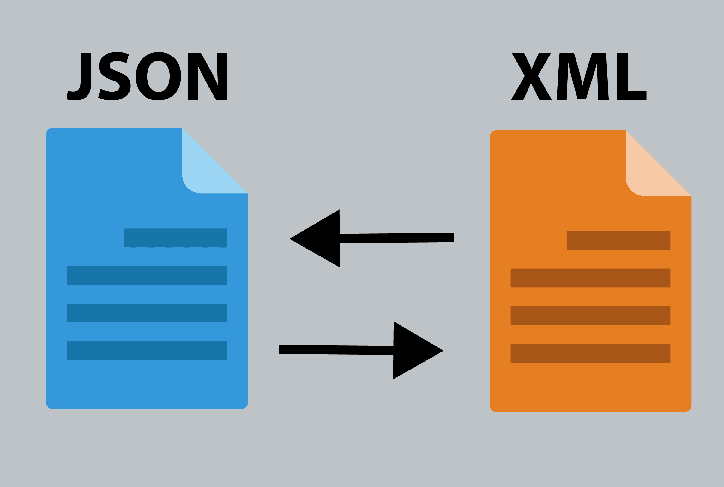


Slide 16
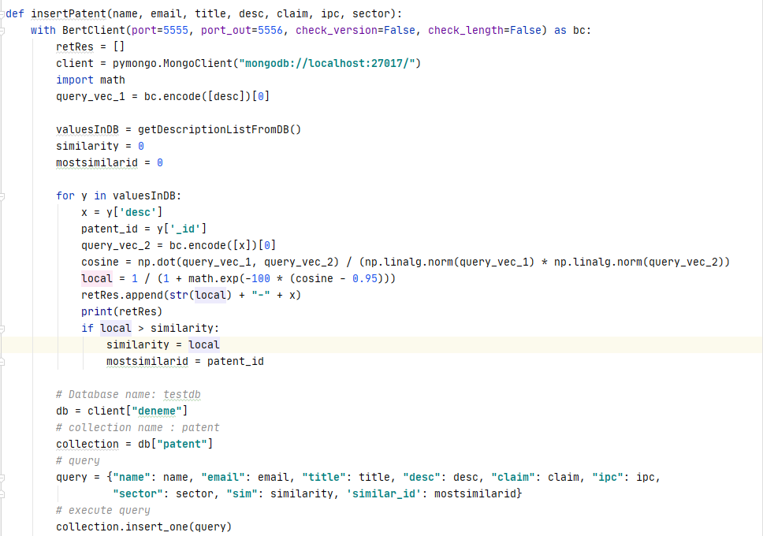

Slide 17


Slide 18

RESULT AND CONCLUSION

Slide 19
PROJECT DISTRIBUTION
NEVAL ZEYNEP GUNDESLI
OZNUR OZTURK
OZLEM SIMAY CELKAN
MERT KIZILDAG
BERT
PYTHON
DJANGO
MONGO

Slide 20
DEMO

Slide 21
THANKS
Do you have any questions?

